Slide 1

The Jenny Hatch Justice Project:
Ways to Advance Supported Decision-Making for People with Developmental Disabilities

Slide 2
Independent advocacy and monitoring
  Children and adults with disabilities
Dignity, respect, and autonomy
  Rights protection and decision-making supports
Jenny Hatch Justice Project (2013 to present)
  www.JennyHatchJusticeProject.org
National Resource Center for Supported Decision-Making (2014 to present)
  www.SupportedDecisionMaking.org

Slide 3
Project ACTION!
A regional coalition of self-advocates from the District of Columbia, Maryland, and Virginia.
“ACTION!” stand for “Advocacy, Change, Training, Information, Organizing, and Networking”
Mottos: “Let Our Voices Be Heard” and “Nothing About Us Without Us”

Slide 4

Today’s Topics
Introduction to Supported Decision-Making
  What, Why, and How
  Personal Perspectives
Jenny Hatch Justice Project’s Multi-Modal Approach
  Legal services
  Public education initiatives
  Systemic and law reform
  Publications
Update on U.S. Trends
Notes:
Morgan

Slide 5

Supported Decision-Making: What?
  Supports and services that help an adult with a disability make his or her own decisions, by using friends, family members, and other people he or she trusts:
    to help understand the issues and choices
    ask questions
    receive explanations in language he or she understands, and
    communicate his or her own decisions to others.
  See, e.g., Blanck & Martinis 2015; Dinerstein 2012; Salzman 2011
Notes:
Morgan: SDM really is human decision-making. None of us decisions when we are in a vacuum.

Slide 6

Supported Decision-Making: Why?
  Self-Determination
    Life control — People’s ability and opportunity to be “causal agents . . . Actors in their lives instead of being acted upon
    See Wehmeyer et al., 2000, p. 440
  People with disabilities with greater self-determination are:
    More independent
    More integrated into their communities
    Healthier
    Better able to recognize and resist abuse
    See, e.g., Powers et al., 2012; Shogren et al 2015; Wehmeyer & Schwartz, 1997; Wehmeyer & Palmer, 2003; Khemka, Hickson & Reynolds 2005
Notes:
I have an OT – you have a PHD in your own body and your own condition. Who else knows your buy

Slide 7
More evidence
When denied self-determination, people can:
“[F]eel helpless, hopeless, and self-critical” (Deci, 1975, p. 208).
Experience “low self-esteem, passivity, and feelings of inadequacy and incompetency,” decreasing their ability to function (Winick 1995, p. 21).
Decreased Life Outcomes
Overbroad or undue guardianship can cause a “significant negative impact on . . . physical and mental health, longevity, ability to function, and reports of subjective well-being” (Wright, 2010, p. 354)
Notes:
Thelma would not be happy, being told .
Ask the question
Read the slide.

Slide 8

More evidence
  People with intellectual and developmental disabilities who do not have a guardian are more likely to:
  Live in their own homes or apartments
  Be included in the community
  Have their rights respected
  Have community jobs or service plans with that goal
  Be supported to communicate with friends
  Go on dates and marry
  Be involved in making choices about their own lives.
  See Bradley et al., National Core Indicator Data Brief, 2019

Slide 9

Supported Decision-Making: How?
  There is no “one size fits all” method of Supported Decision-Making
    SDM looks different for different people and support networks
It is a paradigm, not a process or program
  It means working with the person to identify where help is needed and finding a way to provide any help that’s needed, so the person can make his or her own decisions
  The key question is “what will it take?”

Slide 10

Jenny Hatch Justice Project: How?
Created in 2013 after “Justice for Jenny” trial to advance the “Right to Make Choices”
  www.JennyHatchJusticeProject.org
Uses a Multi-Modal Approach:
  Direct legal services
  Public education initiatives
  Systemic and law reform
  Publications

Slide 11

JHJP Direct Legal Services
The Jenny Hatch Justice Project (JHJP) provides legal services to:
  Qualifying low-income DC residents with disabilities who are in or at risk of overbroad or undue adult guardianship
  Qualifying DC and Maryland residents with developmental disabilities who need assistance with less restrictive legal options for health care decision-making.
DC Bar Foundation
Notes:
We provide legal services to D.C. residents with developmental disabilities and their families on issues including capacity, consent, and alternatives to guardianship; community integration; living life free from abuse and neglect; and accessing public benefits and services.
Through our Jenny Hatch Justice Project, we also provide legal services to qualifying low-income D.C. residents with disabilities who are in or at risk of overbroad or undue adult guardianship or who want help implementing alternatives and advance planning options.
We also provide education, training, and support on topics including Supported Decision-Making and other alternatives to guardianship, school-to-adult transition planning, and public benefits. This includes providing information on the rights of people with disabilities and the topic we are going to discuss today.
DC adult residents with disabilities who:
Have questions about their decision-making rights
Are unhappy with their guardian and want help
Want help with less-restrictive forms of decision-making support, such as:
Supported Decision-Making
Powers of Attorney
Advance Directives
Other Legal Options
Contact: Jessica A. Bronson, JHJP Staff Attorney
202-448-1448
jbronson@dcqualitytrust.org

Slide 12


JHJP Direct Legal Services (continued)
Our mission is to be person-centered.
People should have autonomy over their own life and their own decisions.
People with disabilities can make their own decisions with the support they choose and want.

Slide 13

A “Rethinking Toolbox”:
Supported Decision-Making Strategies
Tools include:
Be open-minded
Actively listen to people with disabilities
Adapt to all communication styles

Slide 14

More Supported-Decision Making Strategies
Practicing law is not one-dimensional
Be creative and flexible
Learn about people’s interests and passions
Be curious and inquisitive

Slide 15

Public Education Initiatives
In partnership with Project ACTION!
Educating people with disabilities, family members, professionals in health, direct support, legal, and educational arenas
Dispelling myths about supported decision-making and guardianship

Slide 16

JHJP Systemic Reform: DC’s Major Milestones
August 2013 – DC Public Schools revises its policy to include the option of SDM for adult students in special education and to create an SDM form.
October 2014 – DC lawmakers pass a law saying SDM and powers of attorney are an option for adult students in special education
July 2016 – DC Office of State Superintendent of Education adopts rules recognizing SDM and issues a model SDM form
October 2016 – Ryan King becomes for the first DC resident to have a guardianship ended for SDM
May 2018 – DC becomes the 4th U.S. jurisdiction to put SDM Agreements into its law

Slide 17
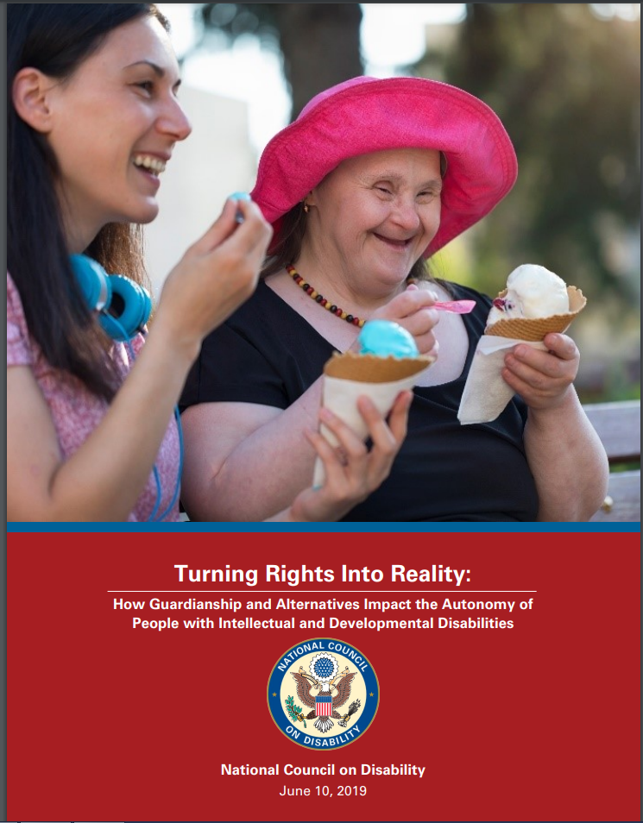
Publications
June 2019 – National Council on Disability issues its second report on guardianship and alternatives, called “Turning Rights Into Reality”
  Included comprehensive review of adult guardianship in the context of federal civil rights laws and policies impacting people with intellectual and developmental disabilities.
  Included a chapter on the experience of DC residents with intellectual and developmental disabilities
  Available at www.ncd.gov

Slide 18
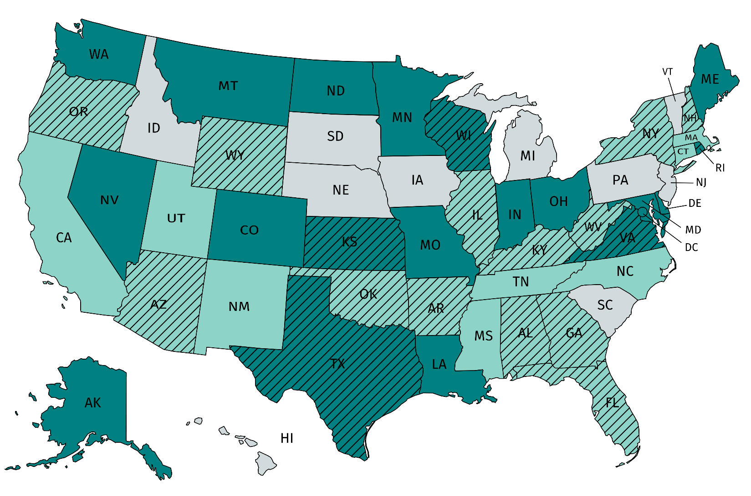
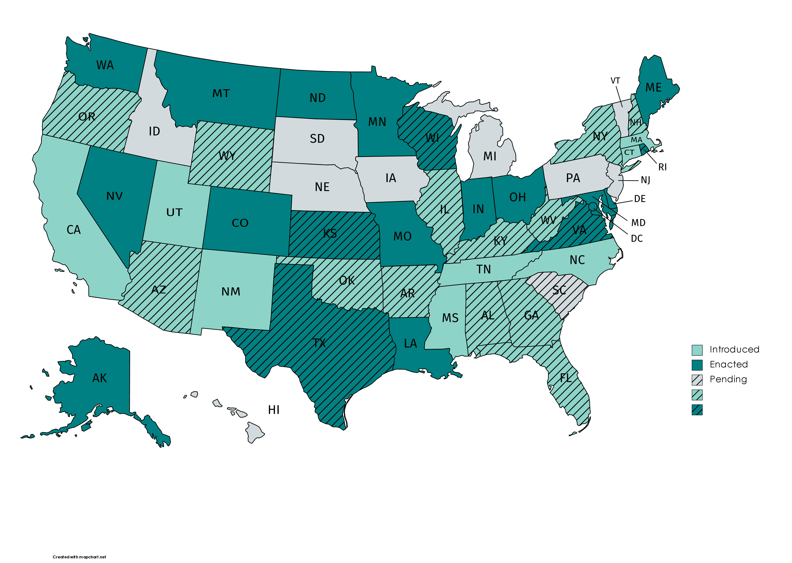
State SDM Legislation and/or Resolutions
As of March 1, 2021

Slide 19
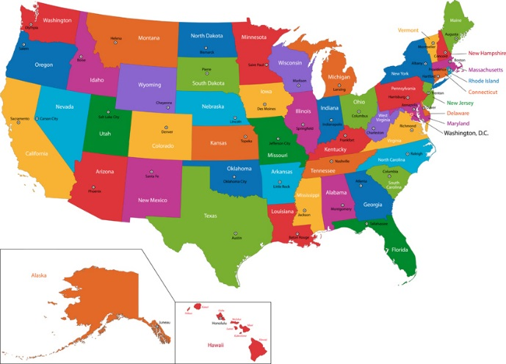
More U.S. State Trends in SDM
NRC-SDM State Grant Program
  18 projects so far
  DC, DE, FL, GA, IN, ME, MN, MS, NC, NV, NY, OR, SC, TN, WI
Court Orders and Decisions
  Examples: DC, FL, IN, KY, MA, ME, MN, NV, NY, PA, VA, VT, and more!
SDM Pilots
  Examples: AK, CA, FL GA, IN, KY, MA, ME, NY, VT, TX, and more!
http://www.supporteddecisionmaking.org/States

Slide 20
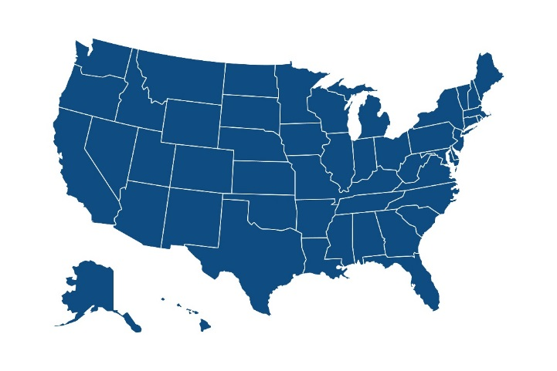
Looking Nationally…
U.S. Administration for Community Living
National Resource Center for Supported Decision-Making (2014 to present)
National Guardianship Association (2016)
Social Security Advisory Board (2016)
AAIDD & The Arc of the U.S. (2016)
American Bar Association (2016 & 2017)
Uniform Law Commission (2017)
U.S. Dept. of Education Office of Special Education and Rehabilitative Services (2017, 2020)
National Council on Disability (2018 & 2019)
U.S. Senate Special Committee on Aging (2018)
Alternatives to Guardianship Youth Resource Center (2020 -2025)

Slide 21

Ask Questions Now or Later
Holly Ceasar, JHJP Staff Attorney
Quality Trust for Individuals with Disabilities
202-449-1448
hceasar@dcqualitytrust.org
Leonard Stevens, Project Coordinator
Project ACTION!
leo.stevensprojectaction@gmail.com
Morgan K. Whitlatch, Legal Director
Quality Trust for Individuals with Disabilities
202-459-4004
mwhitlatch@dcqualitytrust.org

Slide 22
References (Part 1 of 3)
Peter Blanck & Jonathan G. Martinis, “The Right to Make Choices”: The National Resource Center for Supported Decision-Making, 3 Inclusion 24 (2015)
Valerie Bradley et al., Nat’l Core Indicators Data Brief, What Do NCI Data Reveal About the Guardianship Status of People With IDD? (Apr. 2019), https://www.nationalcoreindicators.org/upload/core-indicators/NCI_GuardianshipBrief_April2019_Final.pdf.
Tina M. Campanella & Morgan K. Whitlatch, Supported Decision-Making: U.S. Status and Trends, 32 Impact 1 (2019), https://publications.ici.umn.edu/impact/32-1/supported-decision-making-us-status-and-trends
Edward Deci, Intrinsic Motivation (1975).
Robert D. Dinerstein, Implementing Legal Capacity Under Article 12 of the UN Convention on the Rights of Persons with Disabilities: The Difficult Road From Guardianship to Supported Decision-Making, 19 Human Rights Brief 8 (2012)

Slide 23
References (Part 2 of 3)
Ishita Khemka, Linda Hickson & Gillian Reynolds, Evaluation of a Decision-Making Curriculum Designed to Empower Women with Mental Retardation to Resist Abuse, 110 Am. J. Intellectual and Developmental Disabilities 193 (2005).
Nat’l Council on Disability, Beyond Guardianship: Toward Alternatives that Promote Greater Self-Determination at 60 (2018), https://ncd.gov/publications/2019/turning-rights-into-reality
Nat’l Guardianship Assoc., Position Statement on Guardianship, Surrogate Decision-Making, and Supported Decision-Making (Sept. 20, 2017), https://www.guardianship.org/wp-content/uploads/2018/09/SupportedDecision_Making_PositionStatement.pdf.
Laurie E. Powers et al., My Life: Effects of a Longitudinal, Randomized Study of Self-Determination Enhancement on the Transition Outcomes of Youth in Foster Care and Special Education, 34 Children and Youth Servs.’ Rev. 11 (2012).
Leslie Salzman, New Perspectives on Guardians and Mental Illness: Guardianship for Persons with Mental Illness - A Legal and Appropriate Alternative?, 4 St. Louis Univ. J. of Health L. & Pol. 279 (2011).

Slide 24
References (Part 3 of 3)
Karrie A. Shogren, Michael L. Wehmeyer, Susan B. Palmer, Graham G. Rifenbark & Todd Little, Relationships Between Self-Determination and Postschool Outcomes for Youth with Disabilities, 48 J. of Special Educ. 256 (2015).
Michael L. Wehmeyer & Susan B. Palmer, Adult Outcomes for Students with Cognitive Disabilities Three-Years After High School: The Impact of Self-Determination, 38 Educ. and Training in Developmental Disabilities, 131 (2003).
Michael L. Wehmeyer, Susan B. Palmer, Martin Agran, Dennis E. Mithaug & James E. Martin, Promoting Causal Agency: The Self-Determined Learning Model of Instruction, 66 Exceptional Children 439 (2000), Michael L. Wehmeyer & Michelle Schwartz, Self-Determination and Positive Adult Outcomes: A Follow-up Study of Youth with Mental Retardation or Learning Disabilities, 63 Exceptional Children 245 (1997).
B.J. Winick, The Side Effects of Incompetency Labeling and the Implications for Mental Health Law, 1 Psychol. Pub. Pol. L. 6 (1995).
Jennifer L. Wright, Guardianship for Your Own Good: Improving the Well-Being of Respondents and Wards in the USA, 33 Int’l J. of L. & Psychiatry 350 (2010)

